Slide 1
Mental Health in Tech Survey
Phase-4

Slide 2
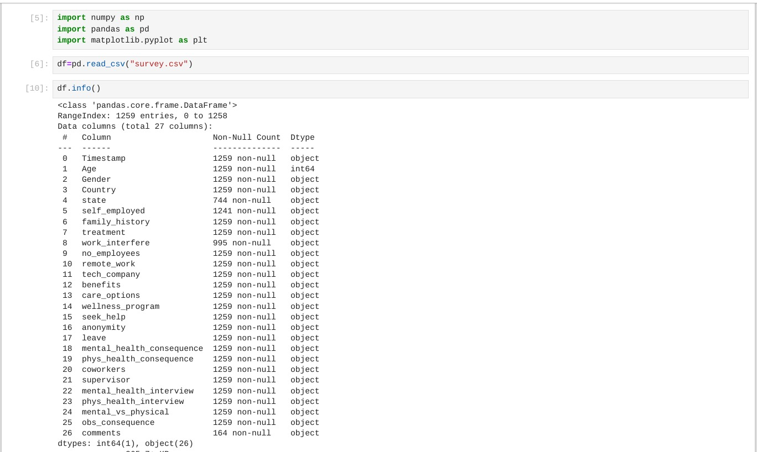
Importing the python libraries like (pandas, numpy, matplotlib)

Slide 3
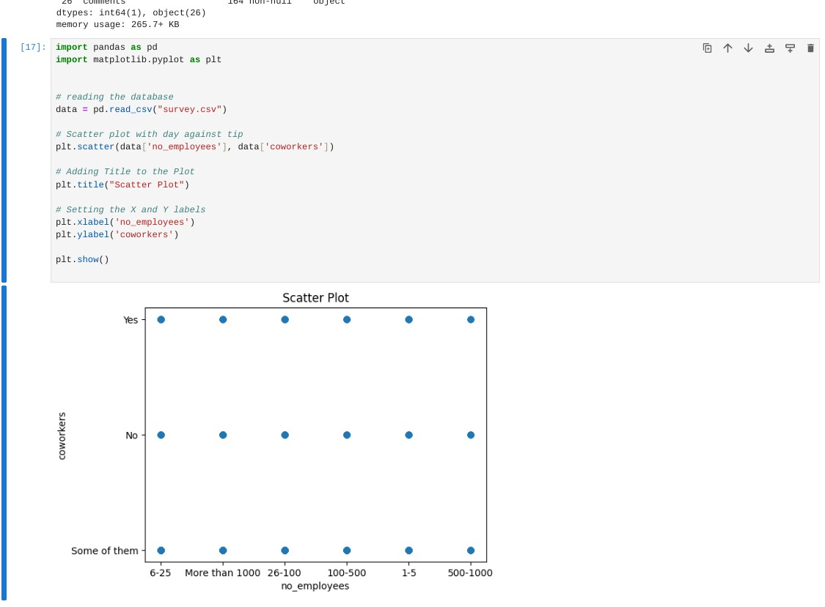
Using matplotlib library to visualize the dataset in scatter plot type:

Slide 4
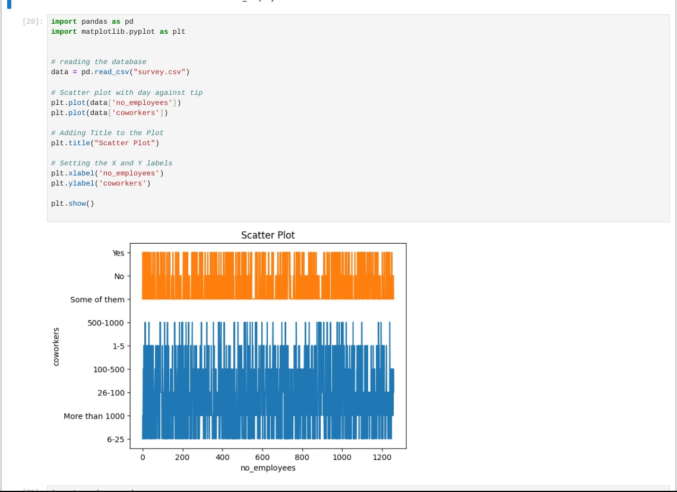
Analysis the dataset plotting using matplotlib.pyplot - library

Slide 5
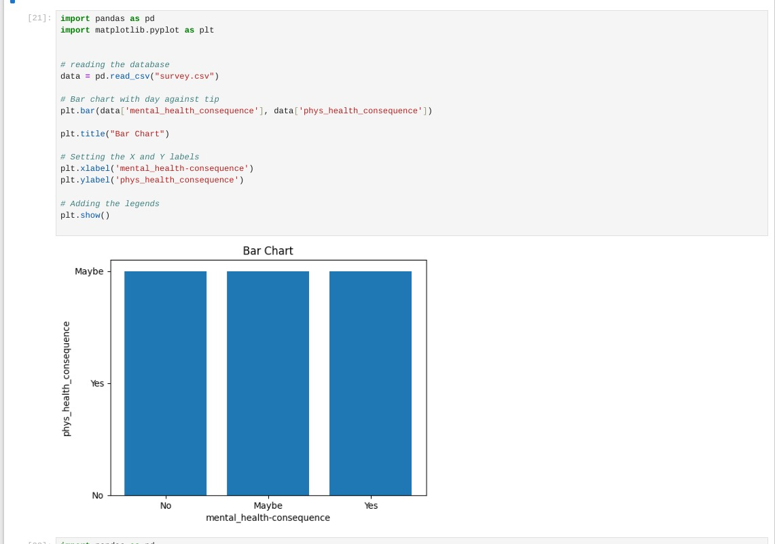
Taken the two columns given datset to visualize the data’s in bar plot:

Slide 6
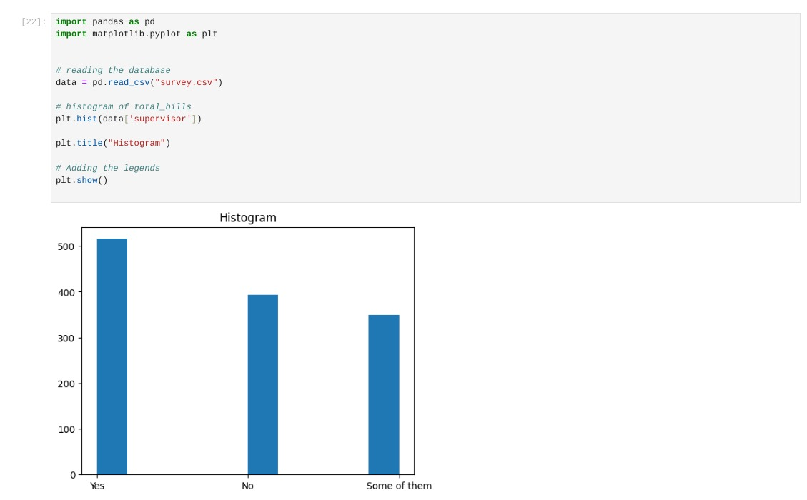
Visualize the dataset in histrogram :

Slide 7
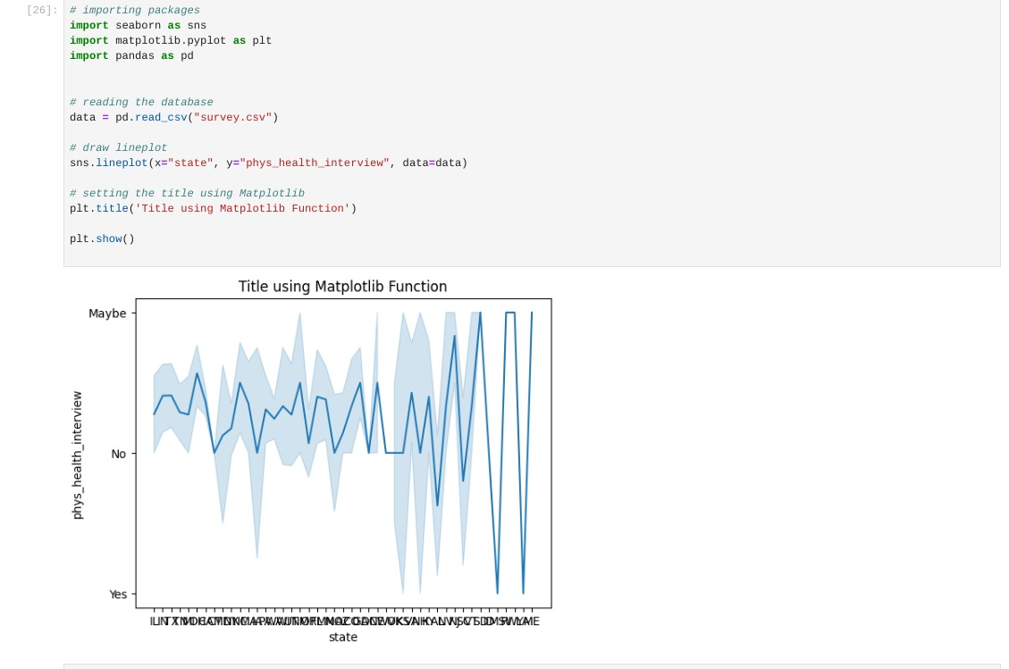
Importing the seaborn to analysis and visualize the graph in given dataset :

Slide 8
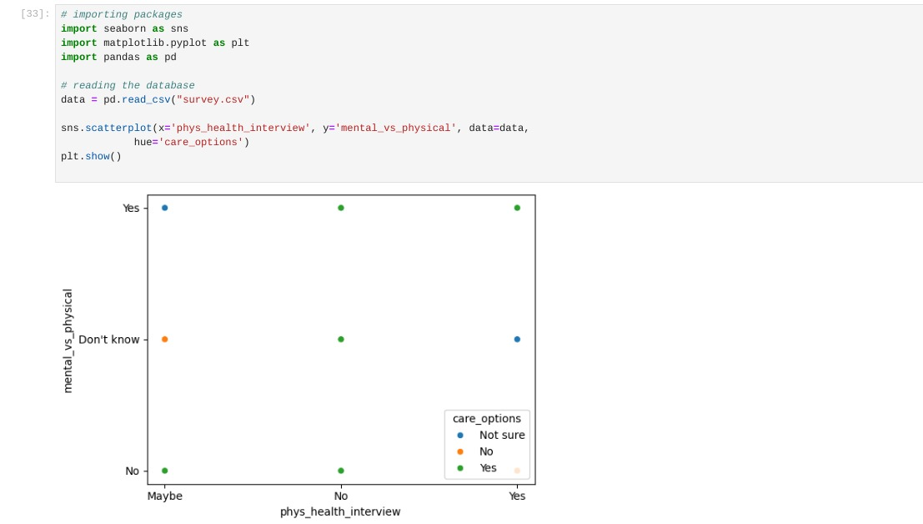
Visualize the data’s in scatter plot using sns(seaborn plotitng):

Slide 9
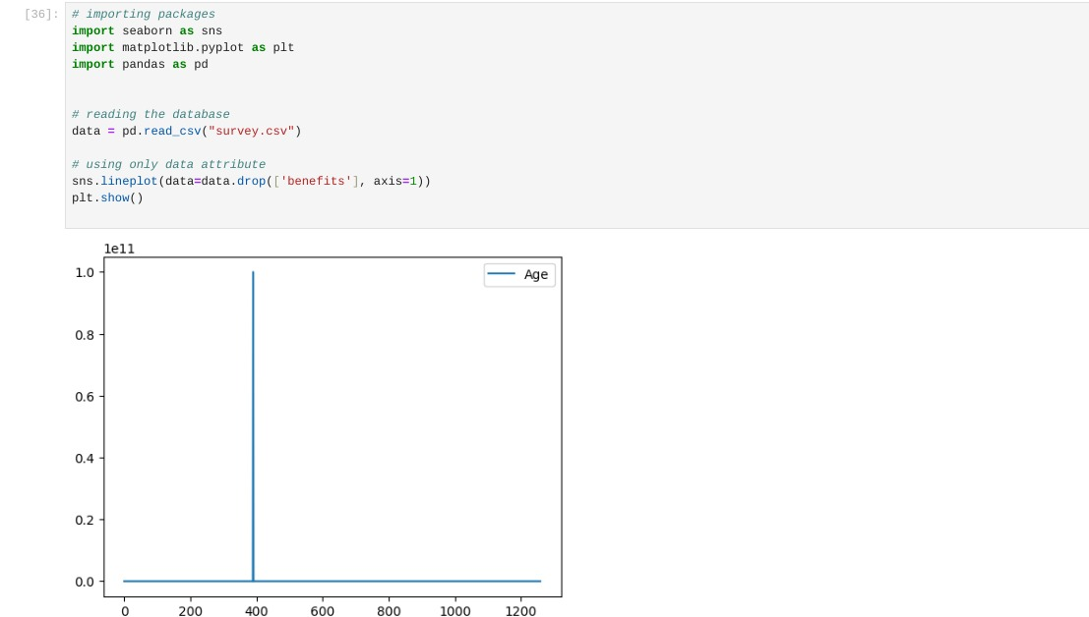
Visualize the dataset in Line Plot using seaborn library:

Slide 10
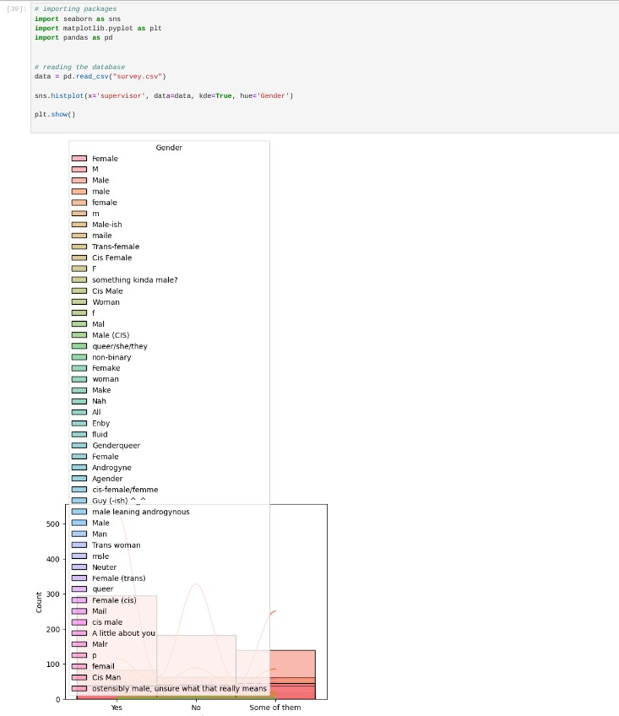
Taken the ‘supervisor’ column in given dataset to visualize the histplot :

Slide 11
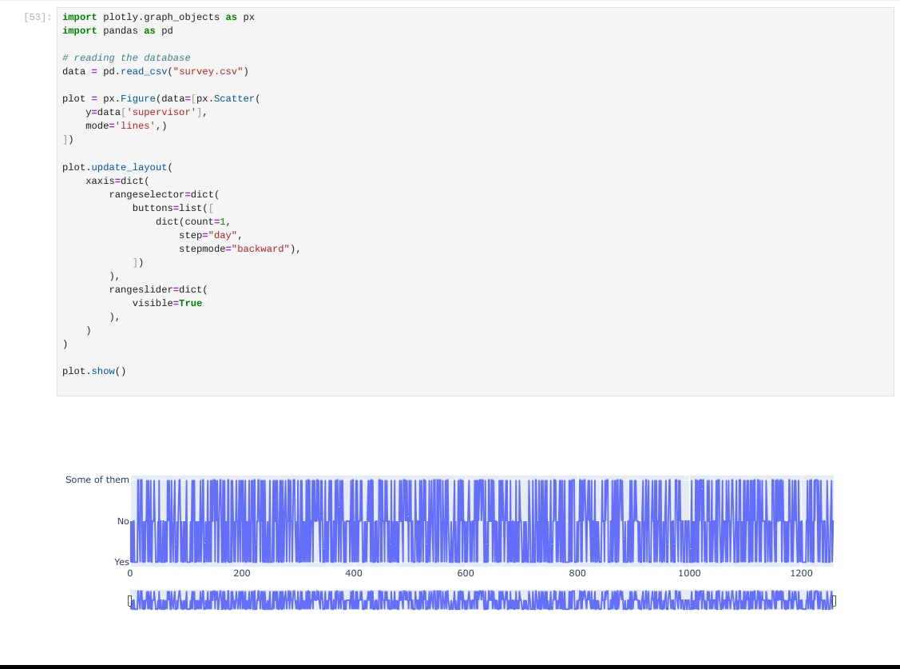
Import plotly .graph_objects to visualize the data:

Slide 12
Thank you…!

